Slide 1
Camila Sleep App
Performance Review
TEAM 4 - Haruko Okada, Sergio Martelo, Mingi Lee, Dylan Laurianti
April 17th, 2024
Notes:
10

Slide 2
Project Summary
App for parents and sleep coaches to track babies sleep and other related events
Web app for coaches and administrators to manage and chat with their clients
Notes:
Sergio 50

Slide 3
Progress Estimation per Epic
100%
Client Onboarding
Backend API / Database
Mobile UI
Web UI
90%
80%
65%
Notes:
Sergio 110

Slide 4
Progress Estimation per Epic cont.
100%
Event Tracking
Chat
Docs / Style
DX
Deployment
60%
90%
90%
70%
Notes:
Sergio 100

Slide 5
MVP (mobile)
Authentication using Auth0
Onboarding flow for clients
Home page
Sleep Tracking
Food Tracking
Medicine Tracking
Notifications
Crisp UI
Baby Statistics
Notes:
Haruko 40

Slide 6
MVP (web)
Authentication using Auth0
Index page of clients and their babies
Baby details page
Manage sleep plan for clients
Coach-client assignment
Twilio Chat
Notes:
Haruko 20

Slide 7
Project Management
Jira
Fibonacci system voted on at sprint planning
Multiple issue types each with a template
Meetings
Informal structure, always planned next meeting at end of meeting
Agile
Sprint Retro/Planning done in 1 meeting at start of next sprint
Notes:
40

Slide 8
Project Management
Notion
Meeting Minutes always taken
Documentation for how to use different tools from developer who set them up
PRs
Simple template, with description, few Qs, and link to issue
2 reviewers required for merge
Github Actions
Runs all tests, gets coverage, requires linting and formatting to pass
Notes:
50

Slide 9
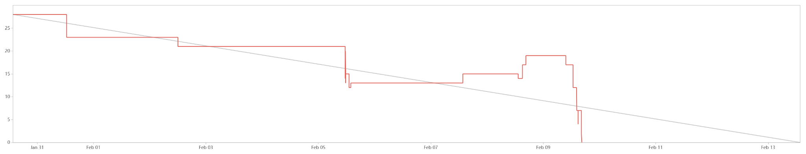
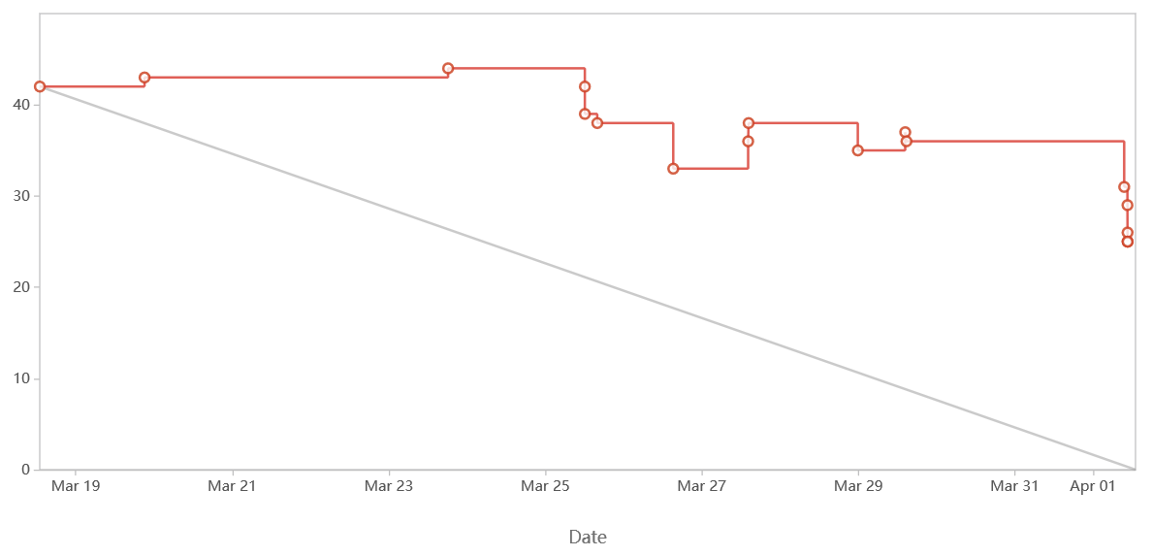
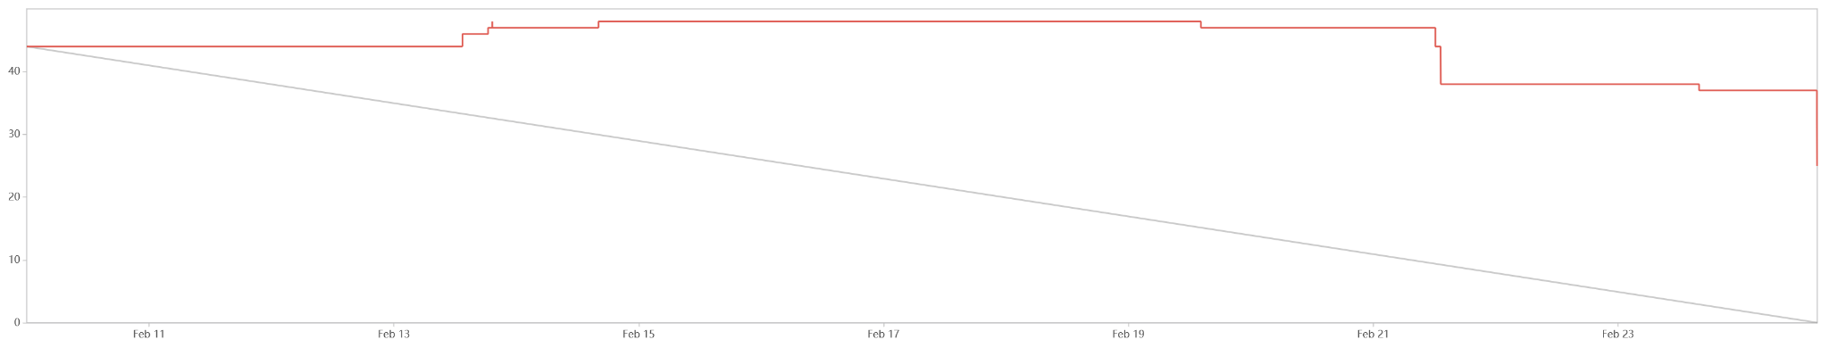
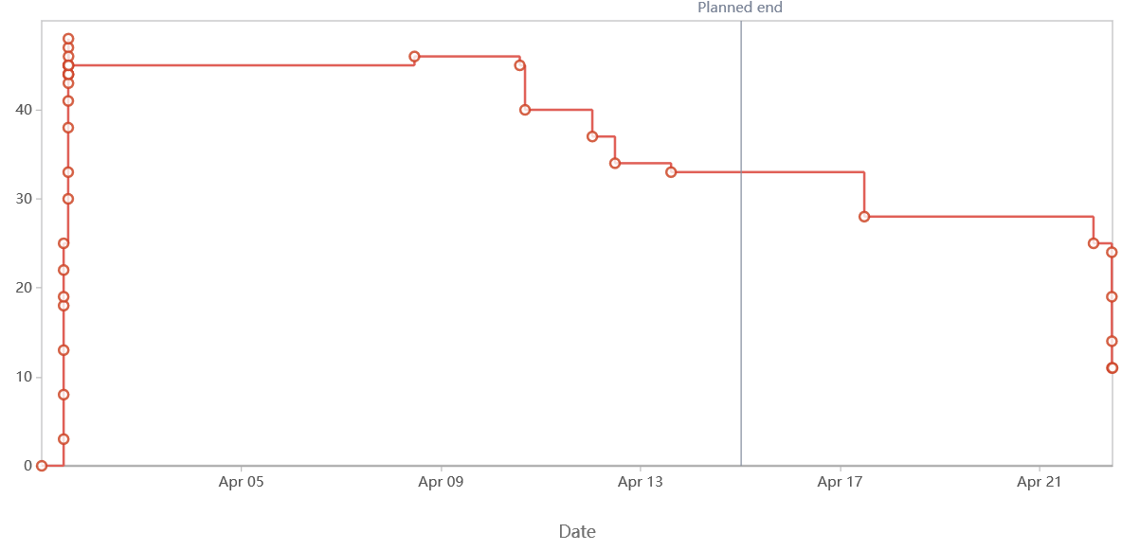
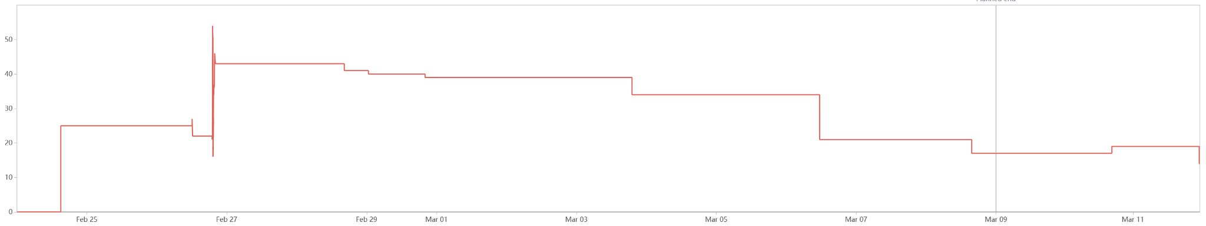
Burndown Analysis
Sprint 1
Sprint 4
Sprint 2
Sprint 5
Sprint 3
Notes:
23

Slide 10
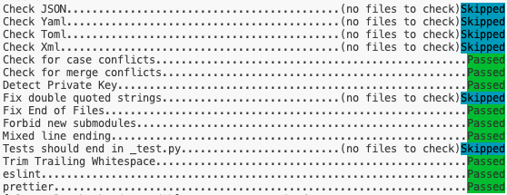
DevOps Pipeline
Docker environments provide consistent development experience and stable local testing platform
Pre-commit enforces linting, formatting, etc. at the commit level
Testing & code quality workflows run on each pull request
Working on Heroku multi-container continuous deployment

Slide 11
Testing
Extensive unit testing for backend API using Prisma & Auth0 mocks, integration testing with PostgreSQL container
Web & Mobile tests built alongside components/features
Code Coverage reported and archived alongside every PR

Slide 12
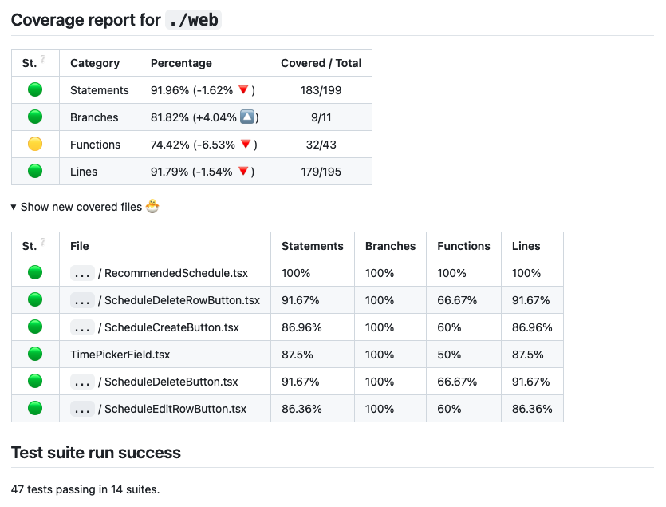
Code Coverage Report

Slide 13
Client Interaction
Team meetings with client to hash out feature details
Email chains with client for design details and questions
Shared Notion Wiki page
Shared Figma mockups/design document

Slide 14
Setbacks
Unforeseen mishaps with implementing chat feature
Mocking difficulties when testing external libraries with TypeScript
Development environment differences causing mayhem
Difficulty estimating the points for stories
AWS free plan not good enough, had to switch to Heroku
People getting blocked on issues
Haruko’s laptop doesn’t work

Slide 15
Questions / Feedback

